Slide 1
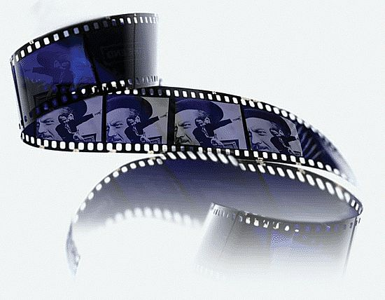
The Film System

Slide 2
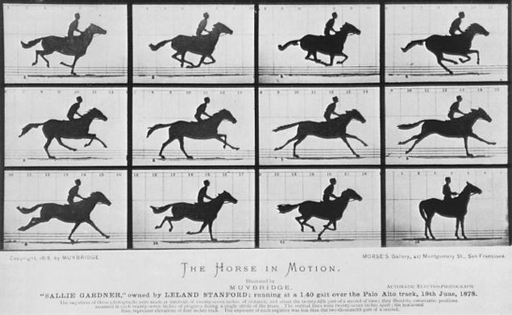
The Moving Image
15 frames in 1.5 sec.
The impression of continuous movement in a motion picture is an illusion.
Studies in Animal Locomotion, Eadweard Muybridge, 1878
Notes:
Studies in Animal Locomotion, Eadweard Muybridge, 1878
Links: http://www.kingston.ac.uk/masters-of-photography
Eadweard Muybridge, pioneer of the moving image, is best remembered for this series of images capturing the gallop of a horse. These photographs settled the heavily-contested debate that a horse in stride will actually lift all four of its legs from the ground. Muybridge used 12 cameras, activated sequentially at 1/200ths of a second by the horse's movement over trigger strings. These motion studies, in giving form to time, carved the path for cinema and had a lasting resonance within the art world, influencing works from the Italian Futurists onward to Stan Brakhage.

Slide 3
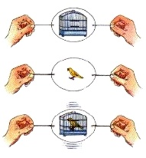
The Moving Image
The film camera records a series of still photographs in rapid succession (usually 24 frames per second, “24fps”).
After the film is developed, these images are projected on a screen. Since the brain retains the image longer than it is actually exposed to them, it melds the two images into one, creating a smooth transition between them.
This phenomenon is called persistence of vision and is responsible for the illusion of motion in film, flip books and video.
Thaumatrope
How You See (1936)
http://video.google.com/videoplay?docid=199329636975555707#
Notes:
The Thaumatrope is a cardboard disk either mounted on a top or held between two pieces of string. It was a popular toy in Victorian times. A famous example of the Thaumatrope would be the "Bird and the Cage" Illusion. A drawing of a bird would be on one side of the disk, and a cage would be on the other. When the top is spun, or when the strings are pulled, the disk spins, and the bird appears to be in it's cage.
The name roughly means "magic disk" in modern Greek.

Slide 4
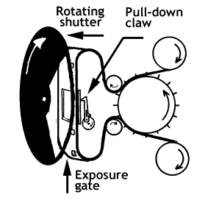
The Moving Image
The camera works by focusing light from the scene to be photographed onto a small rectangular area of the film (the frame).
After each frame is exposed to light the shutter blocks off the light.
The claw then pulls more film into position and holds it in place.
When the film is at rest, the shutter opens again, allowing light to strike the film.
This stop-start process is intermittent movement.

Slide 5
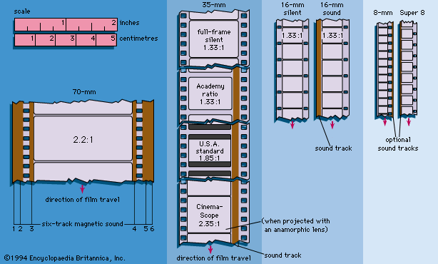
Film Format
A film’s format refers to the width of the film itself (mm) as well as the size and shape of the image recorded onto it (aspect ratio).

Slide 6
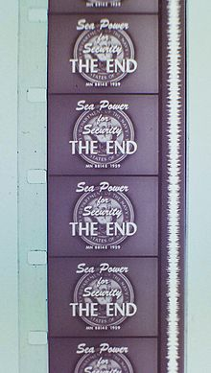
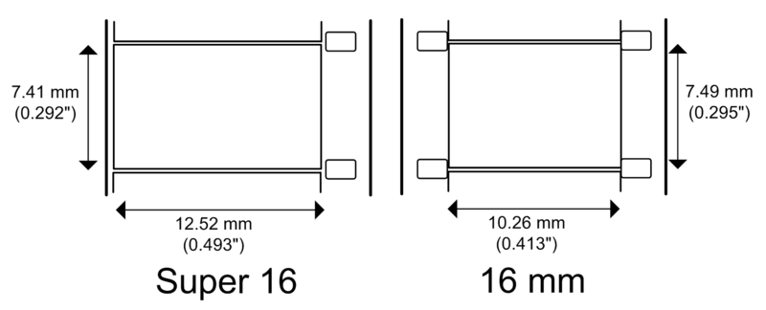
Film Format
16mm and Super 16mm (S-16) formats use film of the same width or gauge,
but the size of their frames are different.
Regular 16mm accommodates either a sound track or is double “perf”
(perforations, i.e. sprocket holes, on each side of the film).
A strip of single perf 16mm
film with Super 16-sized frames.
16mm sound movie – with sound track on single perforation film stock

Slide 7
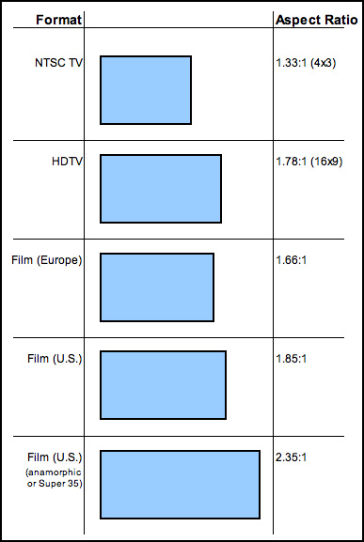
Film Format
The shape of the frame is described by the proportions of the rectangle: the width of the frame divided by the height is the aspect ratio.
Aspect Ratio by Bryan Way

Slide 8
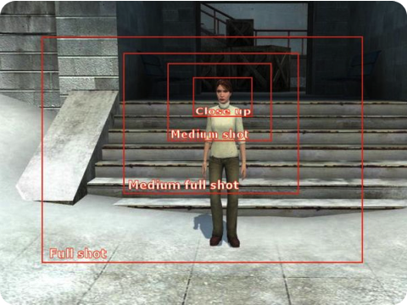
SHOT SIZES & TYPES

Slide 9
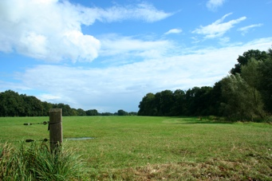
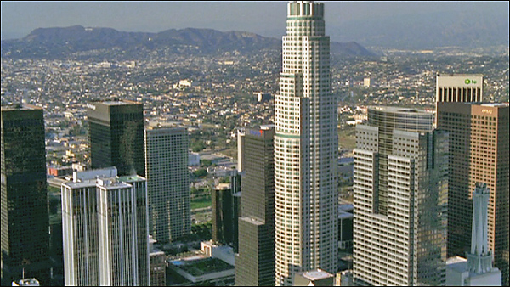
Establishing Shot
A wide angle shot that shows the location of the scene.
Helps to familiarize the audience with where the scene is taking place

Slide 10
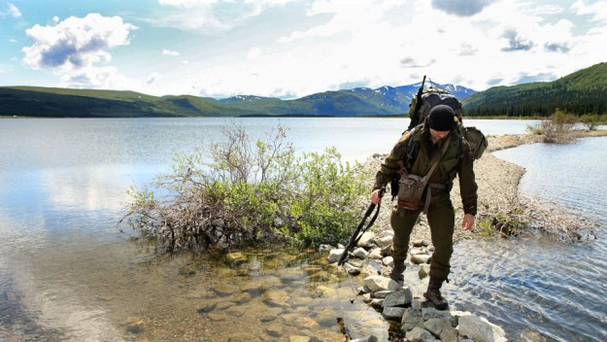
Wide Shot (WS)
Includes the subject's full body and some of the surroundings

Slide 11
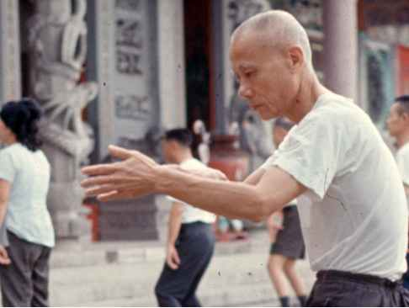
Medium Shot (MS)
Includes about half of the subject’s body and
less of the background

Slide 12
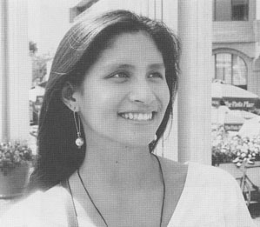
Close-up (CU)
Includes the subject’s head, neck and sometimes shoulders

Slide 13
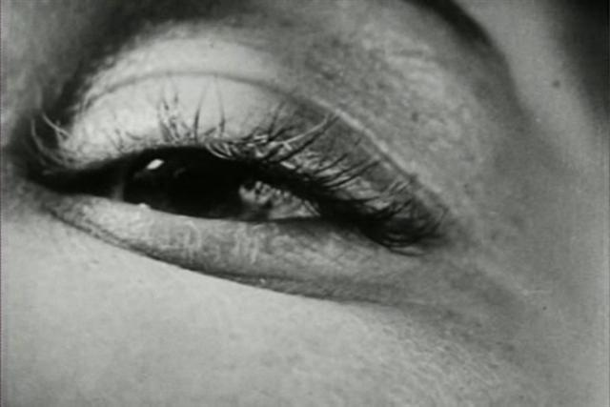
Extreme Close-up (ECU)
Includes only part of the subject’s face
Heightens facial expressions and intensity of actions

Slide 14
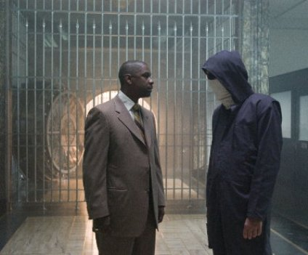
Two Shot
Includes two actors and shows their relative distance from one another
It’s usually a medium shot
A three shot has three characters, etc..., up to a “crowd shot”

Slide 15
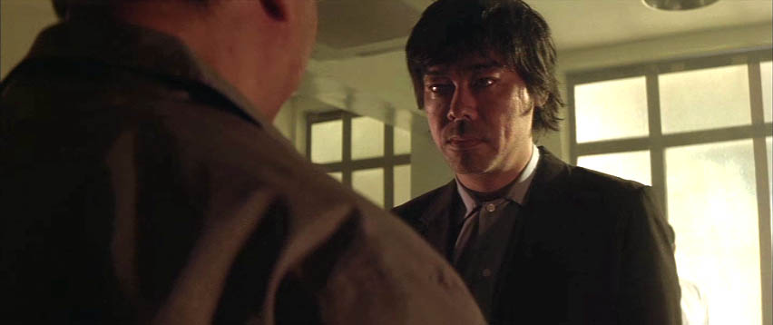
Over the Shoulder (OTS)
Includes two actors, but the face of one and the back of the head/shoulder of another
Psychologically brings characters closer together

Slide 16
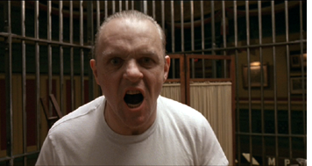
Point of View (POV)
The camera captures what one of the characters sees from their perspective
The other character is often looking straight into the camera, if there is another character

Slide 17
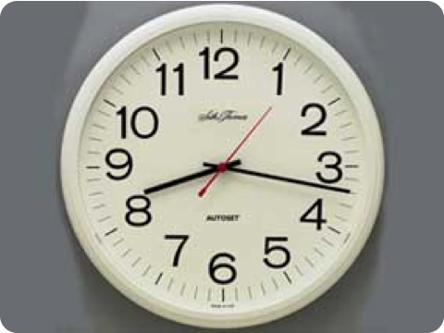
Cut Away (CA) or Insert
A shot of an object in the scene that allows for an easier transition between shots--should be narratively driven
Shot is usually outside the immediate action

Slide 18
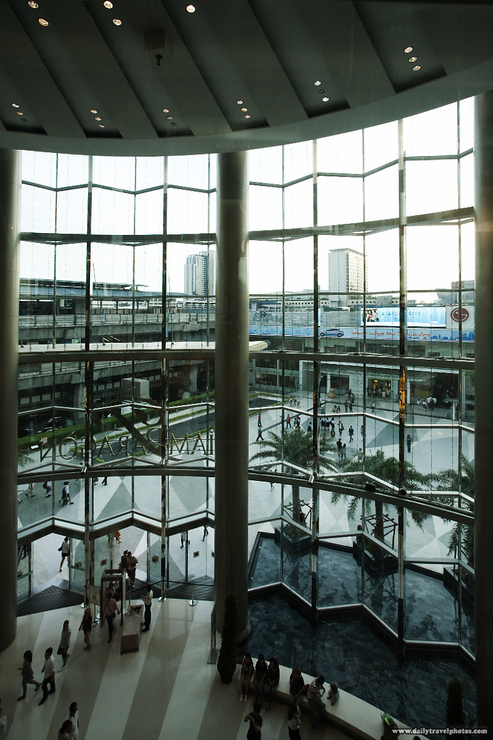
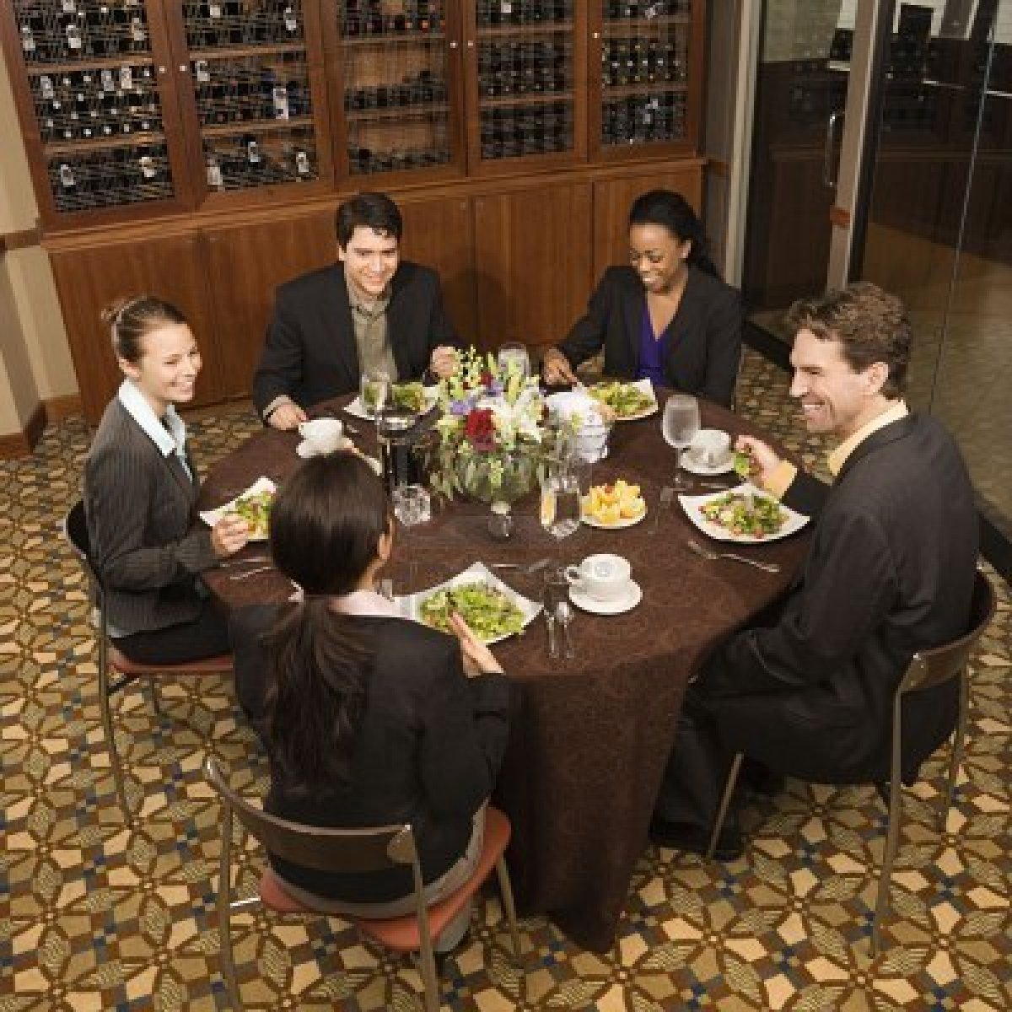
High Angle
The camera points down from above
The subject often looks more vulnerable or insignificant

Slide 19
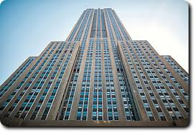
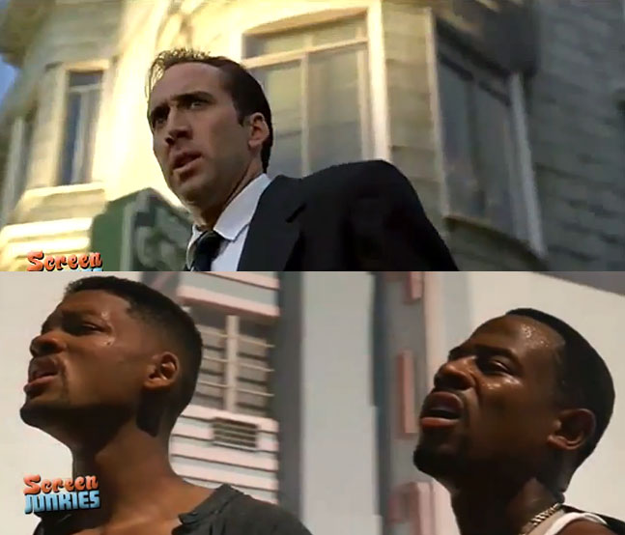
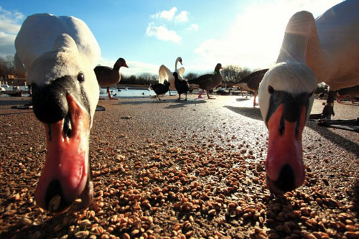
Low Angle
The camera points up from below
The subject often looks more powerful or intimidating

Slide 20
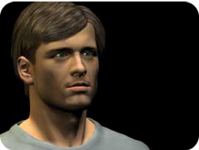
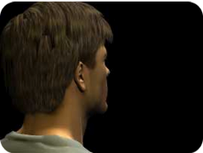
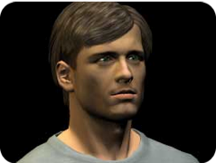
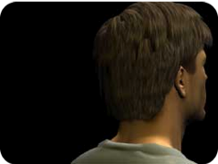
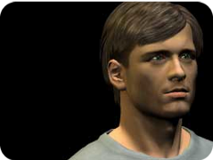
Leading Looks
Directs the eye and indicates where character is looking off-screen (vector)
More ease when room for leading look, more tension when not
Especially important with moving shots

Slide 21
Elements such as composition of the frame, lighting, and distance
from the subject give information that helps tell the story.
Hustle & Flow

Slide 22
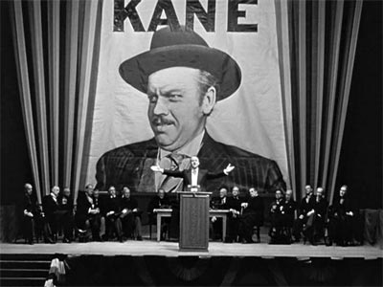
Citizen Kane

Slide 23
Shot Choice
Conventional shot choice
Shot choice in establishing the world of:
Virgin Suicides
The Insider
(on Film Style DVD under Cinematography/Distance)

Slide 24
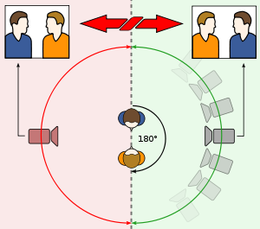
Some “rules”
180° rule
This schematic shows the axis between two characters and the 180° arc on which cameras may be positioned (green). When cutting from the green arc to the red arc, the characters switch places on the screen.
30° rule - moving the camera less than 30 degrees will seem like a jump cut
Cutting on action / matched action

Slide 25
Taxi Driver storyboards by Martin Scorcese

