Slide 1
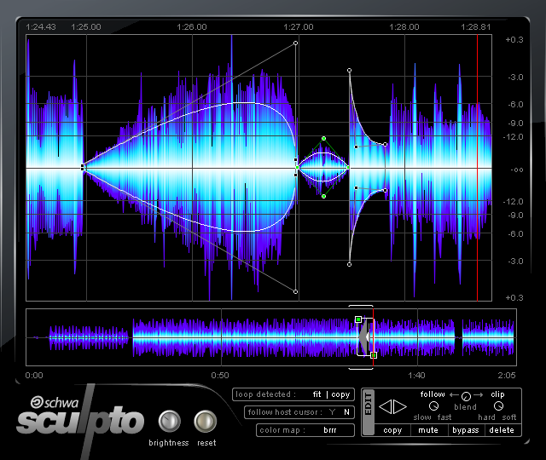
Sound Editing, Mixing

Slide 2
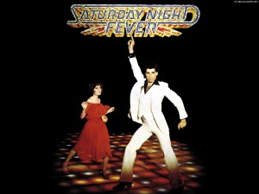
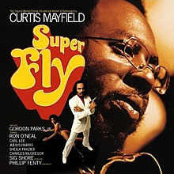
Sound is extremely important to the experience of watching a movie. An image can be invested with a vastly different sense of mood, location, and context, depending on the sound that accompanies it. Music that accompanies the main titles of a film often articulates rhythmically the title information itself, establishes the general mood or tone of the film.
Iconic soundtracks:
Anonymous film, what genre?

Slide 4
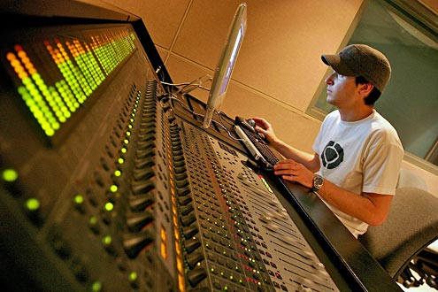
Sound editing refers to the process of creating and refining the sound for a movie. Mixing is the process of enhancing and balancing the sound. On large productions, sound editing is done by specialized sound editors (dialogue, effects, etc.) who are not involved in the picture editing. A sound designer may be brought in to create unique textures and effects.

Slide 5
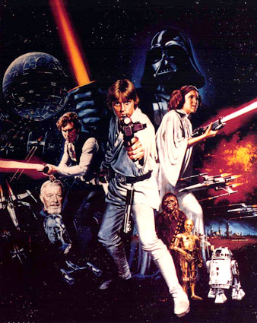
The emotional content of a scene is often conveyed as much or more by music and sound design as by any dialogue or picture. Star Wars Sound Designer, Ben Burtt’s work stands out in how his effects are in the film's foreground. Normally, one only perceives a sound effect on a subconscious level. But Burtt´s skills go far beyond ordinary environmental stretching: his sounds often literally tell the story and they bring pleasure in themselves.
Top 10 Sound Effects
Darth Vader voice-over

Slide 6
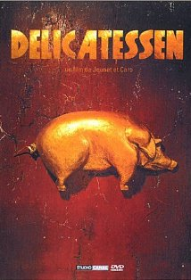
The sound track can enter into an active relation with the image track. Delicatesson, 1991, France

Slide 7
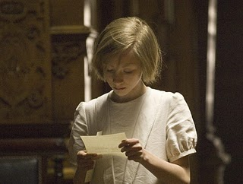
Sound motifs are a combination of sound effects that can be associated with a particular character, a particular setting, and/or with a particular situation or idea throughout the film.
Screen Atonement
Chap. 1 and 12 for sound motif

Slide 8
SOUND BRIDGE Sound bridges can lead in or out of a scene. They can occur when the sound from the previous scene carries over before the sound from the new scene begins. Alternatively, they can occur at the end of a scene, when the sound from the next scene is heard before the image appears on the screen. Sound bridges are one of the most common transitions in the continuity editing style.

Slide 9
SOUND BRIDGE In this clip from Yi Yi (Taiwan, 2000) a sound bridge plays with our expectations. The clip begins with a high angle shot of a couple arguing under a highway. A piano starts playing and the scene cuts into a house interior, to reveal a woman looking at CDs and then a young girl playing the piano. Non-diegetic/diegetic

Slide 10
SONIC FLASHBACK Sound from one diegetic time is heard over images from a later time. Sonic flashback often carries a moral or emotional overtone, making a character's motivation explicit. Sixth Sense, 1999

Slide 11
SOUND PERSPECTIVE The sense of a sound's position in space is used to create a more realistic sense of space, with events happening closer or further away. This clip from The Social Network demonstrates the adjustment of volume and sound quality depending on the action within the scene.
Near dog
Distant dog

Slide 12
SOUND PERSPECTIVE In Woody Allen’s Annie Hall, sound perspective is a creative tool. Allen is not interested in creating a realistic film experience.

Slide 13
To place an unusual emphasis on sound a director may drop the image by fading to black, make the image uninteresting or hold a meaningless shot for a long period. In addition, sound gives a new value to silence. Leaving Las Vegas, 1995

Slide 14
Quality Much like quality of the image, the aural properties of a sound -- its pitch, volume, reverb, sustain, etc. -- have a major effect on a film's aesthetic. A film can register the space in which a sound is produced (its sound signature) or it can be otherwise manipulated for dramatic purposes. The recording of Orson Welles' voice at the end of Touch of Evil (1958) adds a menacing reverb to his confession.

Slide 15
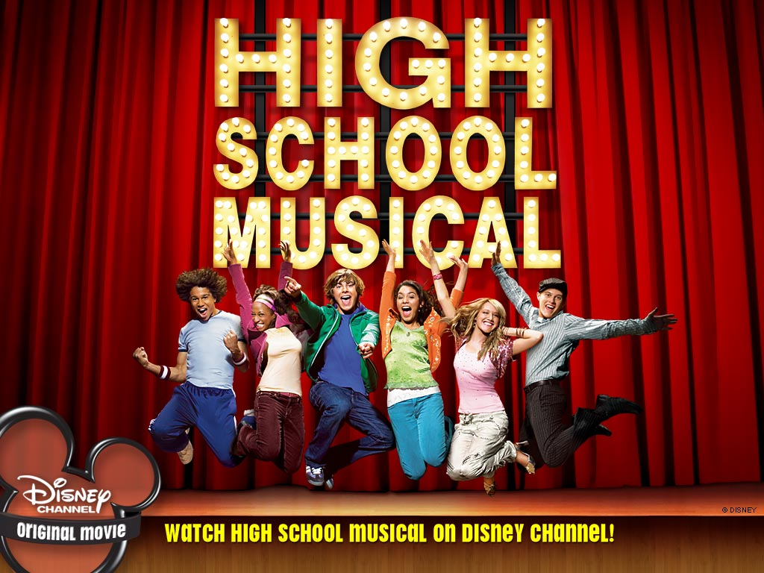
Heavy musical backgrounds can disguise or cover up weaknesses in action and dialogue.
Screen Hitchcock

