Slide 1
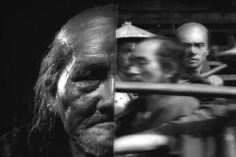
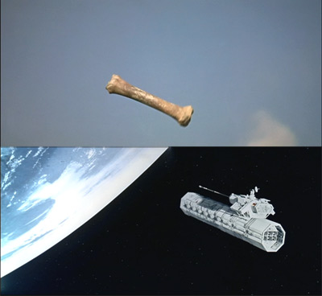
Editing Styles: The patterned use of transitions, matches and duration can be identified as a cinematic style.
Transitions:
Straight cut
Jump cut
Dissolve
Wipe
Insert
Cross-cutting
Shot/Reverse
Matches:
Graphic Match
Matched Action
Eyeline Match
Duration:
Long take
Overlapping Editing
Rhythm

Slide 2
Continuity Editing
A system of cutting to maintain continuous and clear narrative action. Continuity editing relies upon matching screen direction, position, and temporal relations from shot to shot. The film supports the viewer's assumption that space and time are connected between successive shots.
Continuity editing/shooting techniques are:
Long take
Shot/Reverse Shot
Eyeline matches
Matched action
180* rule - unless the transition is smoothed by a POV shot or a reestablishing shot.
30* rule

Slide 3
Continuity Editing
The basic purpose of the continuity system is to create a smooth flow from shot to shot without jarring visual inconsistencies.

Slide 4
Montage An approach to editing developed by the Soviet filmmakers of the 1920s; it emphasizes dynamic, often discontinuous, relationships between shots and the juxtaposition of images to create ideas not present in either shot by itself. The Godfather (1973) - a famous sequence of Michael attending his son's baptism are intercut with the brutal killings of his rivals. Rather than stressing a simultaneous series of the events the montage suggests Michael's dual nature and commitment to both his "families”, through religion and violence.

Slide 5
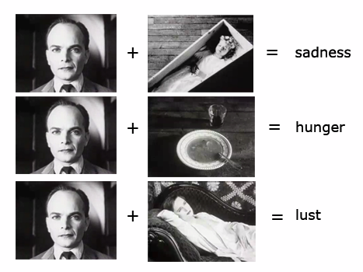
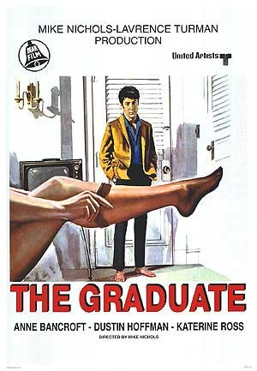
Montage The Kuleshov effect occurs when two shots are joined creating, meaning, significance, emotional impact and tone, but are unable to have a similar effect when viewed without the other.
Screen The Graduate

Slide 6
ELLIPTICAL EDITING is an editing technique that presents an action in such a way that it consumes less time on screen than it does in the story. Shot transitions that omit parts of an event, cause an ellipses in plot and story duration. In this clip from Traffic (2000), a party is rendered through elliptical editing (achieved with dissolves and jump cuts) in order to both shorten the time and suggest the character's rambling mental states.

Slide 7
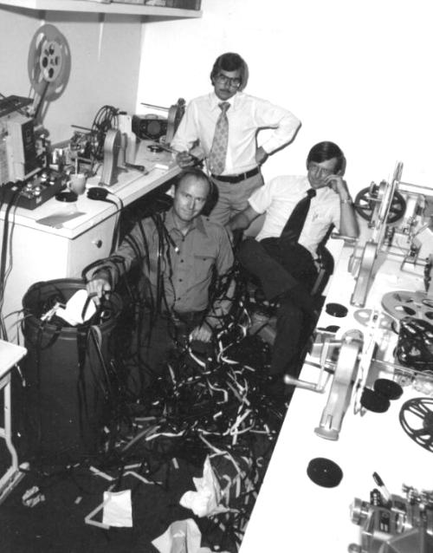
The Editing Process A film editor is a person who practices film editing by assembling footage into a coherent film. Film editors often are responsible for pulling together all of the elements of story, dialogue, music, sound effects, visual effects, rhythm and pace of a film. In the making of a film, the editors play a dynamic and creative role.

Slide 8
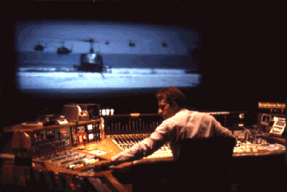
The editors’ assembly of parts must be done with
Artistic Sensitivity
Perception
Aesthetic Judgment
Clear understanding of the Director’s intentions

Slide 9
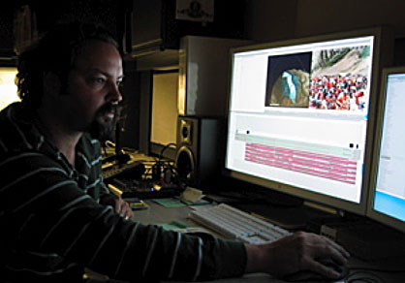
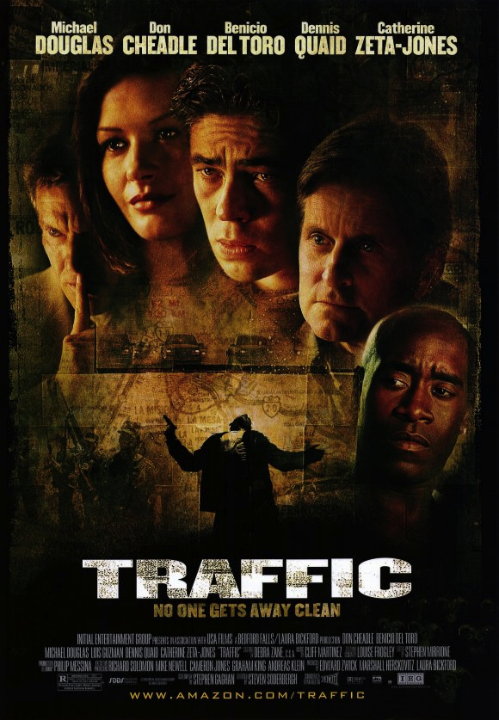
Selects After a film is shot and processed, film and video editors study footage, select the best shots, and assemble them in the most effective way. Their goal is to create dramatic continuity and the right pace for the desired mood.
Screen Traffic clip

Slide 10
Selects 1. Upload/digitize the footage that’s been shot. Do we need to talk about setting scratch disks? And naming clips? 2. Create “bins” for the footage. Some Editors put every scene in its own bin; but you can organize in anyway that’s most comfortable. 3. Open a sequence(s) - Some Editors put every scene in its own sequence, some editors like the entire film in one sequence. I like to use a sequence for all scenes in a single location/time and then combine these into one sequence after the rough cut, but you can organize in anyway that’s most comfortable. 4. A take that is considered “bad” for some element (performance, lighting, etc.) might have a usable section for a cutaway or insert.

Slide 11
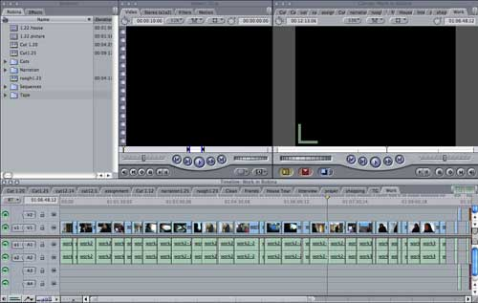
Assembly Editors first organize the footage and then structure the sequence of the film by splicing and re-splicing the best shots. They must have a good eye and understand the subject of the film and the director’s intentions. 1. Put the shots in order with the best takes. 2. Look at which takes will cut and those that will not. If you don’t have a shot that will cut you can re-shoot (recommended) or you can find a creative solution to make a transition (sound and/or image) that will enhance and not hinder the narrative.

Slide 12
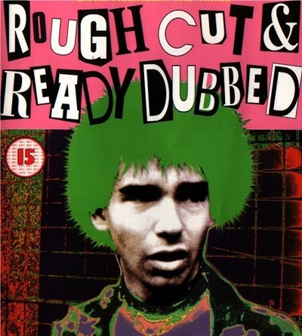
Rough Cut The rough cut is the first attempt at shaping the film. Many editors prefer to edit rough cuts on the long side in order to try out shots and scenes, even if they’re questionable and likely to be cut out later. As the movie continues to edited and refine, you may have several rough cuts. 1. Transitions are applied (though they may change). 2. Sound and music is “synced” to the images.

Slide 13
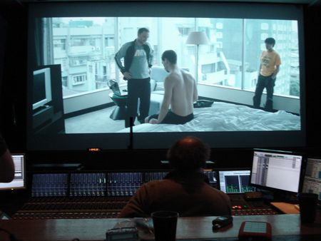
Fine Cut When the basic scene order is in place and you start polishing individual sequences and transitions, this is called fine cutting. It’s often easier to fine-cut and pace individual scenes after you’ve seen the overall flow of the rough cut. Some people prefer to fine-cut from the start of editing instead of making a rough cut. Even though this approach requires more time to complete the first cut, you may be better able to judge the editing.

Slide 14
Fine Cut 1. Transitions (video/audio) polished 2. Sound mix 3. Titles and credits 4. Color correction (if necessary)

Slide 15
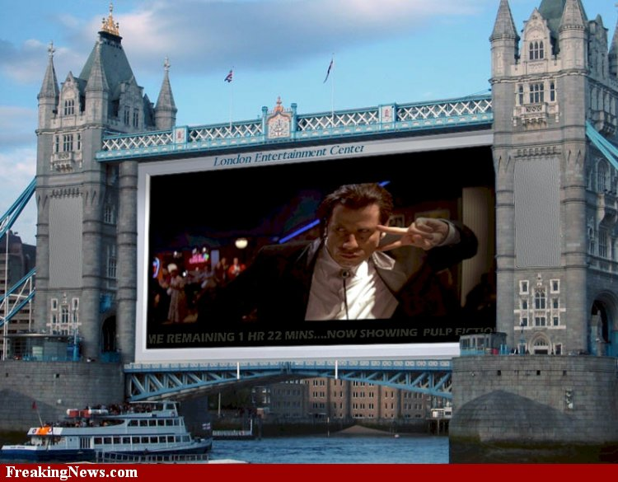
Fine Cut View the movie on a big screen during the editing process. Sometimes the pace of the movie changes, wide shots that might have seemed dull actually reveal interesting details, close-ups might seem over-powering. Cuts that draw the eye’s attention from one side of a screen to the other may seem to jarring.

Slide 16
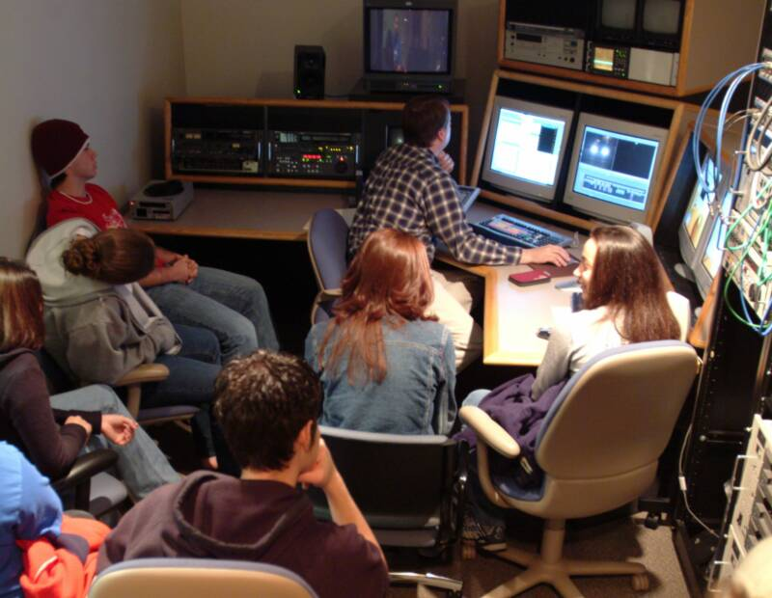
Fine Cut Watching the movie with an audience will help determine whether something in the movie is confusing, boring or doesn’t work.

Slide 17
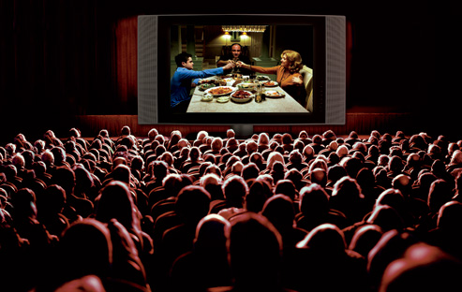
The final cut is the finished edit of a film, approved by the director and the producer. This is what the audience sees.

Slide 18
Sources: http://classes.yale.edu/film-analysis/htmfiles/intro.htm www.tadvin.ir/images/film-editing2.jpg http://en.wikipedia.org/wiki/Eyeline_match

