Slide 1
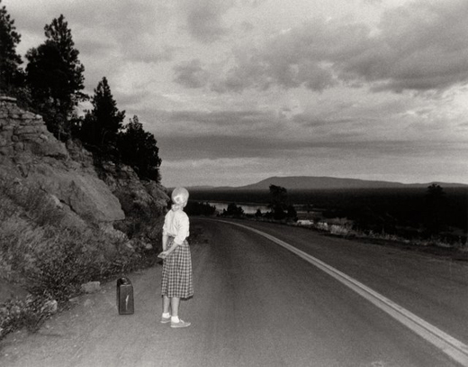
Exposure
Untitled Film Still #48, 1979, Cindy Sherman

Slide 2
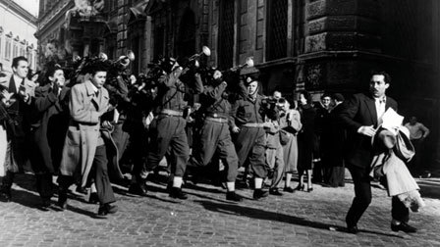
Exposure
When you are filming a scene there is no single correct exposure.
“Correct” exposure means identifying what is important in the scene and exposing that area appropriately.
The White Sheik, Federico Fellini, 1952

Slide 3
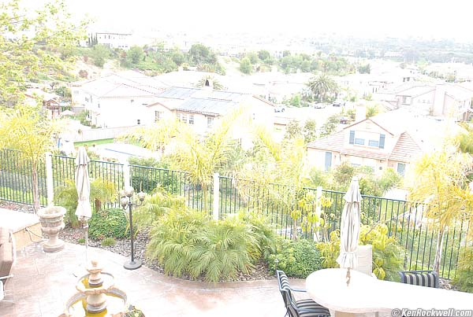
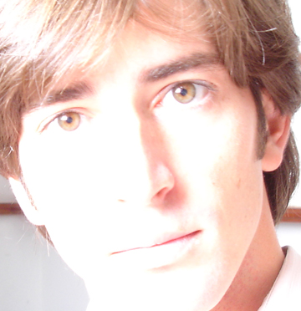
Overexposure
Overexposed images are too bright and lack detail

Slide 4
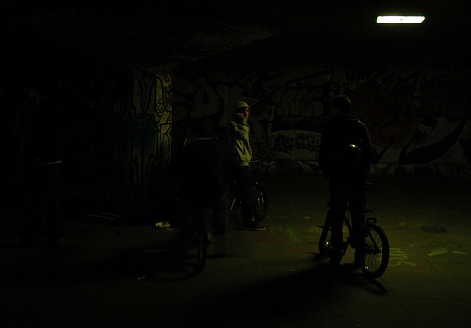
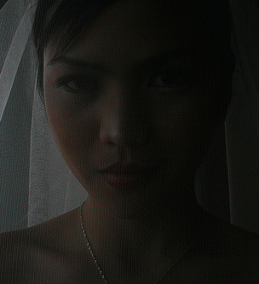
Underexposure
Underexposed film is dark and muddy with no detail in the black areas

Slide 5
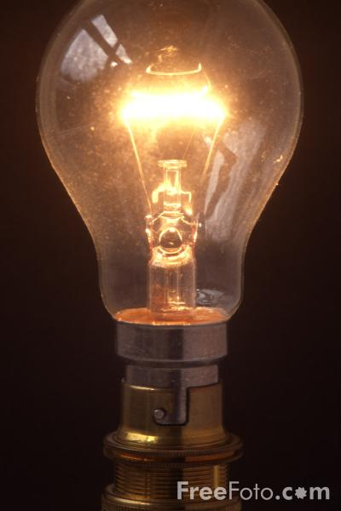
Exposure
There are four ways to
control the exposure
of your film.
the amount of light
the lens (iris/f-stops)
the film speed
the shutter speed

Slide 6
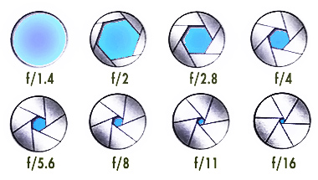
The lens
The lens gathers light from the subject and projects its image onto the film. The light-gathering power of the lens is called the speed of the lens. This is expressed as an f-stop.
As lens diameter (iris) increases, so does the amount of light that passes through the lens. The faster a lens the more light it lets through; the slower a lens, the less light.

Slide 7
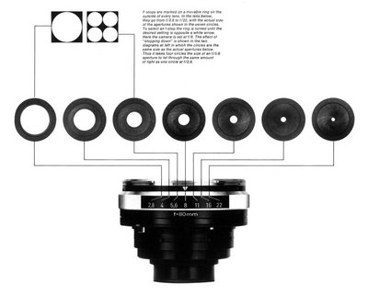
The lens
The iris diaphragm is the device that “closes” down to control the amount of light, which passes through the aperture.
The standard series of f-stops is:
1, 1.4, 2, 2.8, 4, 5.6, 8, 11, 16, 22, 32
Each stop represents the the halving (or doubling) of the amount of light that the lens passes.

Slide 8
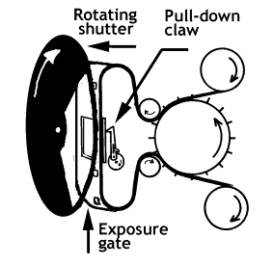
The shutter
We will not be adjusting the shutter speed,
but simply be aware that :
The shutter is a rotating disc with a section removed. It blocks the light from the film between each frame exposure. The 180º shutter, a half-moon in shape, is used in many cameras, particularly in 16mm.
Standard film speed is 24 frames per second (fps). A camera with 180º shutter admits light half of the time (the disc is half open) so the exposure time (the shutter speed) is 1/24 x 1/2 = 1/48 second (which is usually rounded up to 1/50 second).

Slide 9
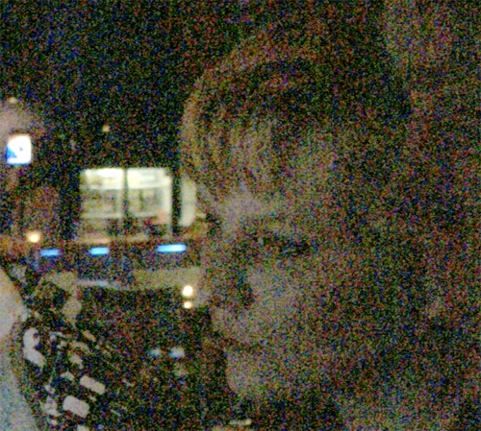
The film speed
The film speed is a measurement of the film’s sensitivity to light. The “faster” the film stock, the less light it needs to reproduce an acceptable exposure.
Although “fast” film is
more flexible, it can
produce a poorer quality
image with more grain
and less sharpness.
Most productions use
different speed stocks for
different scenes (int./faster,
daylight/slower).

Slide 10
The film speed
The exposure index (EI) expresses the speed as a number that can be used with light meters to help determine proper exposure.
Each film stock is given an ASA* number. The metric equivalent is the DIN number with a degree sign. An ISO** number gives the ASA first and then the DIN.
*American Standards Association **International Standards Organization
Kodak’s label- EI 500/28° = ASA 500, DIN 28
A medium speed emulsion will be rated around 100 ASA. ASA speeds below 50 are considered slow. Fast or high-speed emulsions are rated ASA 200 or higher.
(Doubling the ASA number means that the film will twice as sensitive to light. A film rated at ASA 100 needs only half the exposure (one f-stop less) than a film rated ASA 50.)

Slide 11
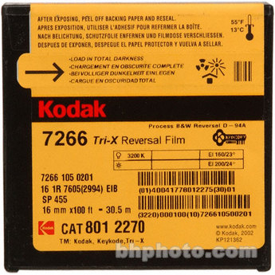
The film stock
KODAK TRI-X
Black & White Reversal Film 7266
$21.62/100’Roll
A high-speed, panchromatic black-and-white film suitable for general interior photography with artificial light. It can also be used in daylight and is particularly useful for sports pictures taken at regular speed or slow motion in weak light (overcast sky or late in the day). This film is characterized by excellent tonal gradation and sharpness.

Slide 12
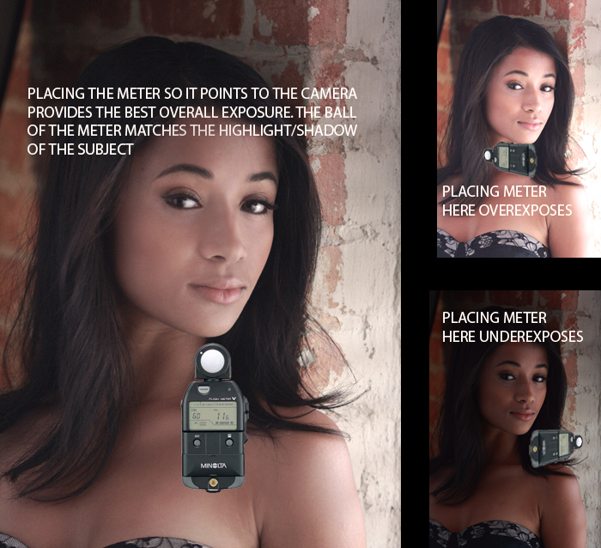
The Light Meter and Exposure Control
The exposure of an object on film is related to the amount of light falling on the object - the incident light.

Slide 13
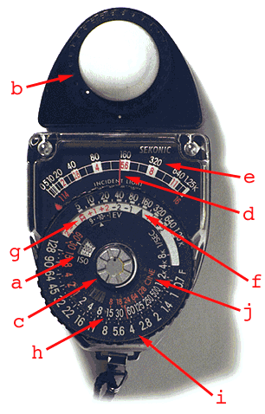
The Light Meter
a. Exposure Index setting
b. the Sphere
c. the Center Button
d. the Needle
e. Foot Candles Scale
f. Pointer for readings without HIGH slide
g. Pointer for readings with HIGH slide
h. the 1/sec. scale, (exposure time)
i. f-stop scale
j. Cine scale

Slide 14
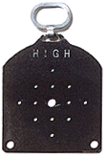
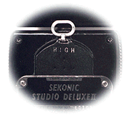
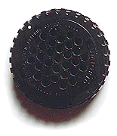
The Light Meter
The HIGH Slide
Used for very bright situations, such as shooting out-of-doors during the day.
The Honey-comb or Grid
This is used for taking reflective readings (with the meter pointed at the subject). As it says on the front, read off the “H” without the HIGH Slide in place. But because it needs a fairly large amount of light, it is not always very useful.

Slide 15
Steps For Taking an Incident Light Reading:
1. Set the light meter to the Exposure Index of the film you are using. [a] You will find this on the box the film comes in, abbreviated E.I.
2. Hold the light meter directly in front of the subject with the sphere [b] pointed at the camera.
3. Depress the center button [c]
4. The needle [d] will be released and move to a reading on the foot candle scale [e].
(Note that there are f-stops marked in red on this scale too. Do not use these to set your lens, as they have no correlation to the film speed.)
On a bright day the needle will likely pin at the top of the scale. Use the HIGH Slide to take your reading. This will lower the amount of light by 5 stops. To use it, put it in the slot on top of the meter behind the sphere.

Slide 16
Steps For Taking an Incident Light Reading:
5. You now turn the dial of the light meter so that the pointer [f] lines up with the number on the foot candle scale above. If the reading is between numbers on the foot candle scale [e], try to be accurate as far as the percentage above or below the number.
Be careful that you don’t change the Exposure Index [a] when you turn the dial.
If you are use the HIGH Slide, line up the number to the red pointer marked with an “H” [g].
6. Now look at the bottom of the dial. There is a red line indicating the f-stop reading [i] and is what you use to set the f-stop on the camera lens. If the reading is between stops, try to be accurate as far as the percentage above or below the stop. You are now ready to shoot.
Note: If you are filming fast or slow motion your shutter speed will be effected. You can use the cine scale [j] to take your reading.

