Slide 1
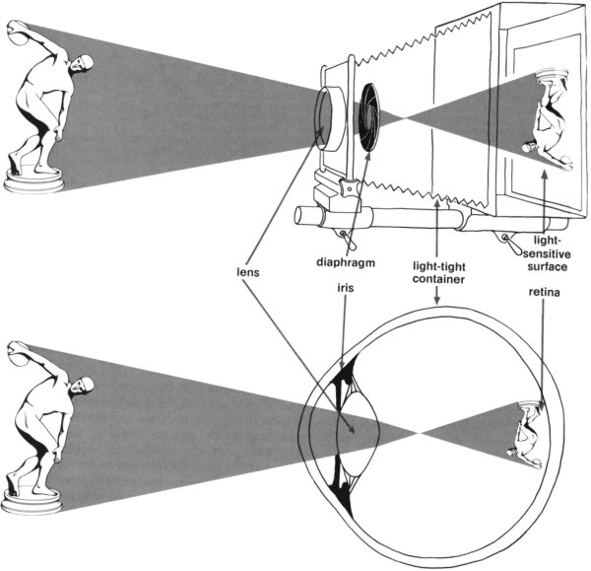
LENSES / OPTICS

Slide 2
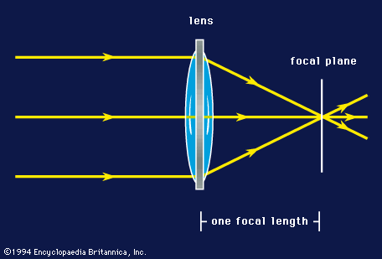
FOCAL LENGTH
When parallel rays of light strike a lens focused at infinity, they converge to a point called the focal point (or plane). The focal length of the lens is then defined as the distance from the middle of the lens to its focal point.
Lenses are defined by their focal length.

Slide 3
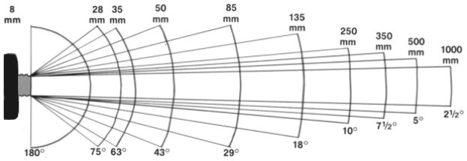
FOCAL LENGTH

Slide 4
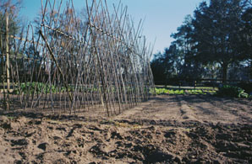
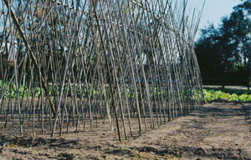
FOCAL LENGTH
Shot focal length: greater depth of field
Long focal length, reduces depth of field
28mm 50mm
70mm 210mm

Slide 5
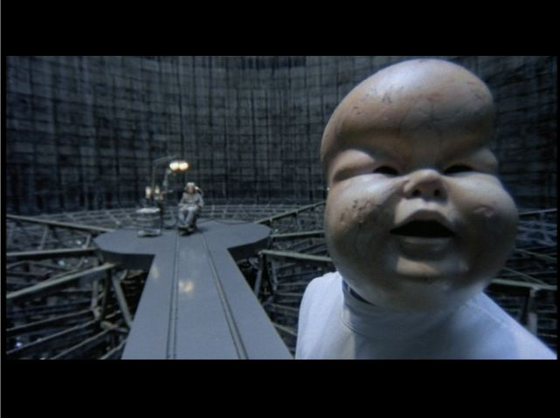
Wide Angle Lens - depth perception is exaggerated, objects appear to be further apart than they are in reality

Slide 6
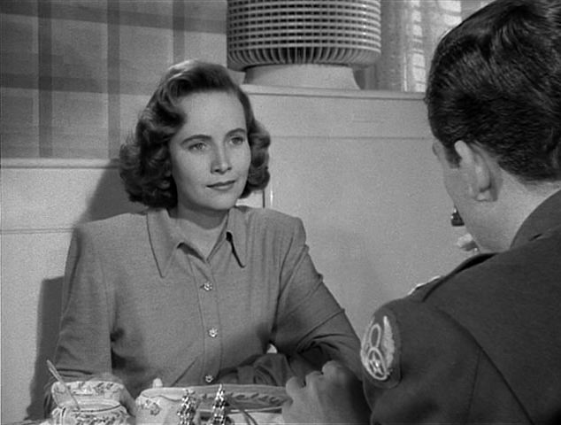
Normal Lens - portrays the depth relationships closest to human vision
16-25mm lens for 16 mm film
35-50mm lenses for 35mm film

Slide 7
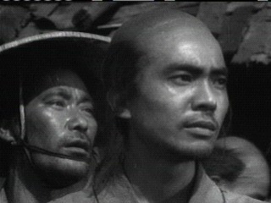
Long Lens (telephoto) - compresses space, has less depth of field and de-emphasize movement away from and towards the camera (35mm and up for 16mm film)

Slide 8
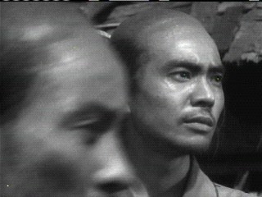

Slide 9
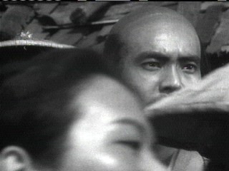

Slide 10
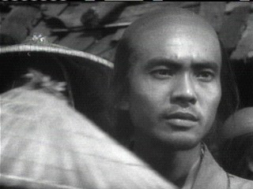

Slide 11
Zoom Lens - focal length can be changed during a shot
Shift to telephoto range flattens the space and magnifies the image
Shift to wide angle increases depth and demagnifies the background

Slide 12
DEPTH OF FIELD
Depth of field refers to the distance of the space that is in focus.
Depth of field can be increased with:
bright light
narrow lens aperture (f-stop) “stopping down”
using a wide-angle rather than a long lens

Slide 13
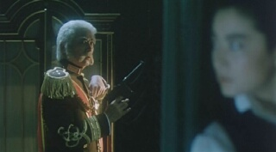
DEPTH OF FIELD
Close-up shooting and shooting in low light conditions often results in images with very shallow depth of field
A shallow depth of field is often used as a technique to focus audience attention on the most significant aspect of a scene without having to use a cut-in.
Peking Opera Blues (Do Ma Daan, Tsui Hark , 1986)

Slide 14
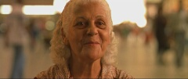
SHALLOW FOCUS
A restricted depth of field, which keeps only one plane in sharp focus is shallow focus. Used to direct the viewer's attention to one element of a scene. Shallow focus is very common in close-up, as in these two shots.
Shallow focus suggests psychological introspection, since a character appears as oblivious to the world around them.
Central Station (Central do Brasil, Walter Selles, Brazil, 1998)

Slide 15
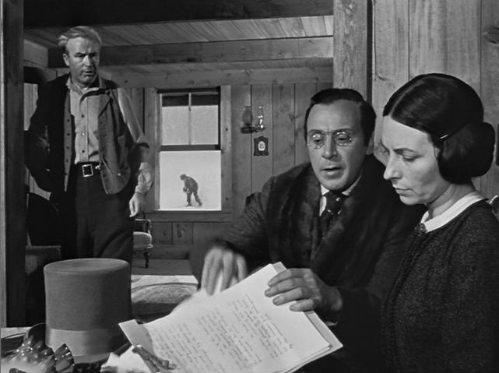
Deep focus requires that elements at very different depths of the image be in focus. While deep focus may be used occasionally, some directors use it consistently for they believe it achieves a truer representation of space.

Slide 16
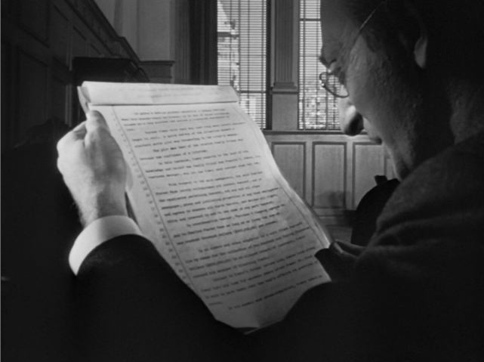

Slide 17
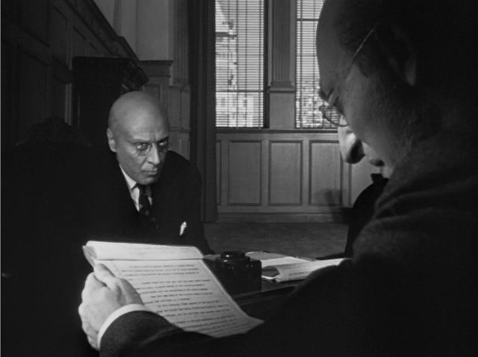

Slide 18
